Slide 1
Unit - 2
Wired LANs
SONET

Slide 2
    14-3 SONET
SONET is a wide area network (WAN), technology that is used as a transport network to carry loads from other WANs.
We first discuss SONET as a protocol, and we then show how SONET networks can be constructed from the standards defined in the protocol.
SONET was developed by ANSI;
SDH was developed by ITU-T.
Both uses synchronous TDM Multiplexing
14.<number>
Notes:
14.#

Slide 3
14.3.1 Architecture
Both are fundamentally similar and compatible.
Let us first introduce the architecture of a SONET system: signals, devices, and connections.
SONET Defines a hierarchy of electrical signaling levels called Synchronous Transport Signal.
Corresponding optical signals are called Optical Carriers.
In SDH it is called Synchronous Transport Module.
14.<number>
Notes:
14.#

Slide 4

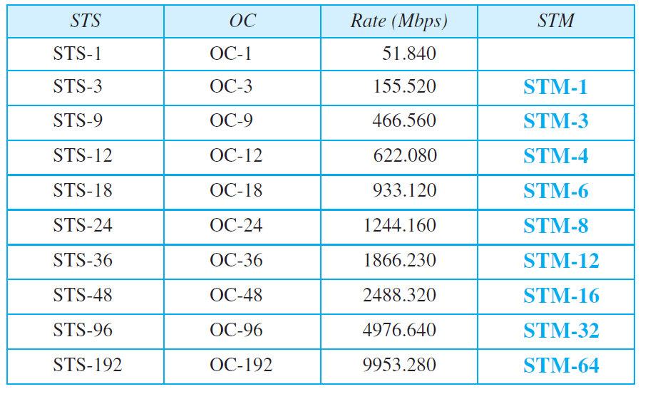
Table 14.1: SONET rates
14.<number>

Slide 5
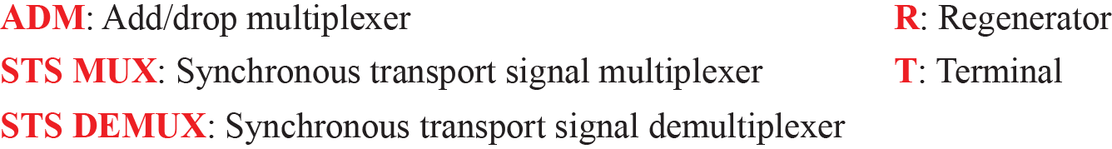
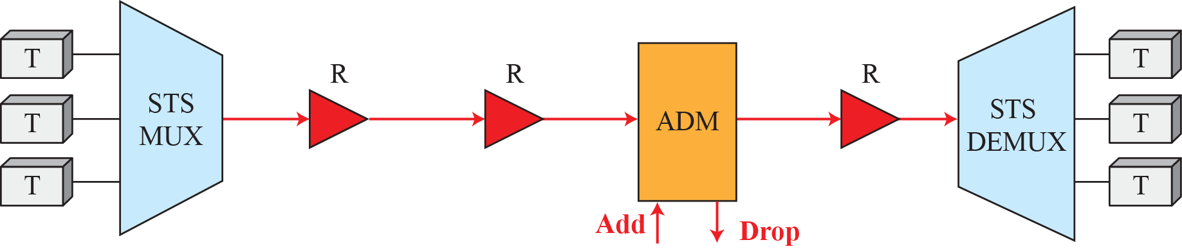
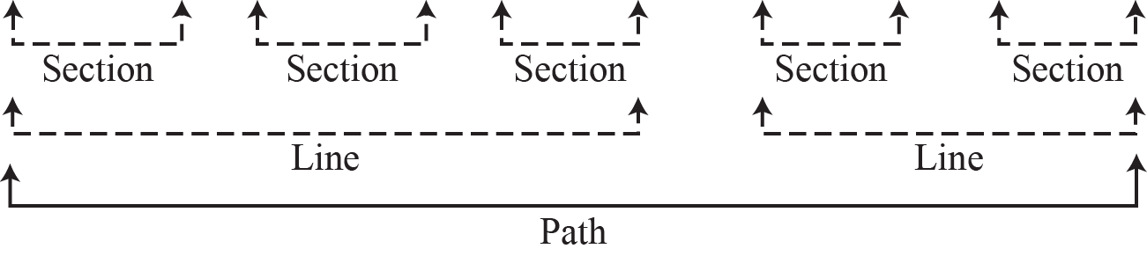
Figure 14.14: A simple network using SONET equipment
14.<number>
Notes:
14.#

Slide 6
SONET Devices
STS Multiplexer / Demultiplexer
Regenerator – Extend the length of the link
Add / Drop Multiplexer – can add STSs coming from multiple sources into a given path or can remove a given signal from a path and redirect it
Terminals

Slide 7
Connections
Sections – optical link connecting two neighbouring devices
Lines – between two multiplexers
Paths – end –to-end portion of the network

Slide 8
14.3.2 SONET Layers
The SONET standard includes four functional layers: the photonic, the section, the line, and the path layer. They correspond to both the physical and the data-link layers (see Figure 14.15). The headers added to the frame at the various layers are discussed later in this chapter.
14.<number>
Notes:
14.#

Slide 9
SONET Layers
Path layer – responsible for movement of signal from optical source to optical destination
Line layer – movement of signal across the line
Section layer - movement of signal across the section. It handles Framing, Scrambling and Error Control
POH. LOH and SOH is added to the frame
Photonic layer – physical specifications of optical fiber, sensitivity of the receiver, multiplexing functions etc.
SONET uses NRZ encoding with presence of light representing 1 and absence of light representing 0

Slide 10
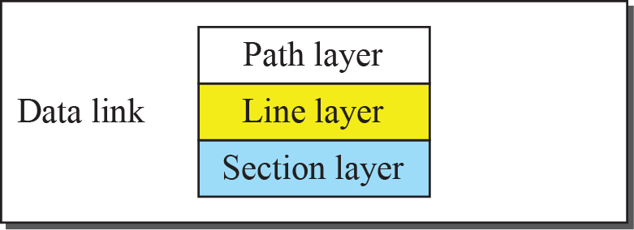

Figure 14.15: SONET layers compared with OSI or the Internet layers
14.<number>
Notes:
14.#

Slide 11
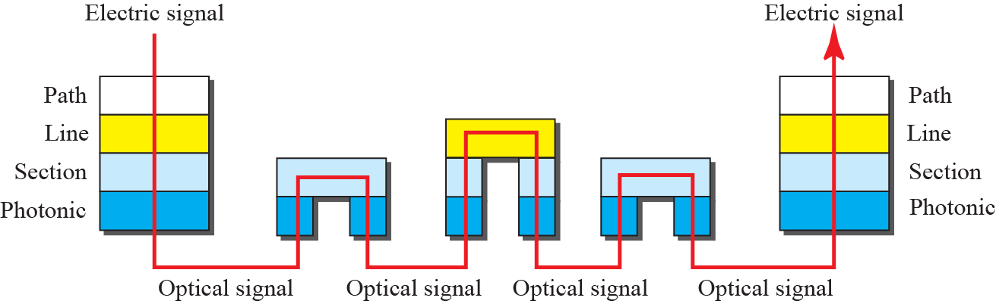
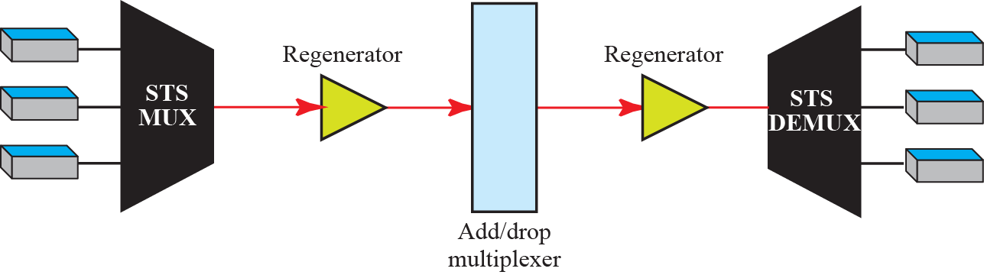
Figure 14.16: Device-Layer relationship in SONET
14.<number>
Notes:
14.#

Slide 12
14.3.3 SONET Frames
Each synchronous transfer signal STS-n is composed of 8000 frames. Each frame is a two-dimensional matrix of bytes with 9 rows by 90 × n columns. For example, an STS-1 frame is 9 rows by 90 columns (810 bytes), and an STS-3 is 9 rows by 270 columns (2430 bytes). Figure 14.17 shows the general format of an STS-1 and an STS-n.
14.<number>
Notes:
14.#

Slide 13
SONET Frames
Each STS – n frame is composed of 9 rows and 90 X n columns
It is transmitted at a fixed rate of 8000 frames per second.
If we sample a voice signal and use 8 bits for each sample, then each byte in a SONET frame can carry a digitized voice channel. (STS-1 frame can carry 774 voice channels – (810 – 36 = 774))

Slide 14
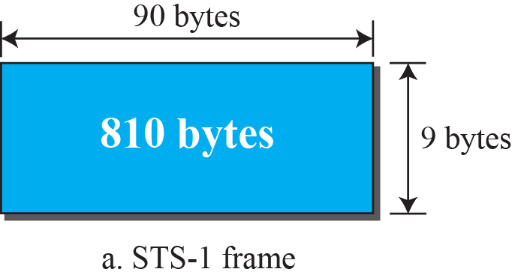
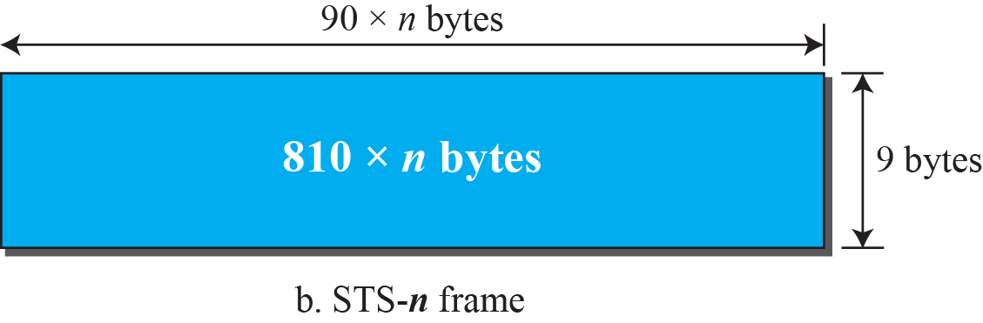
Figure 14.17: An STS-1 and an STS-n frame
14.<number>
Notes:
14.#

Slide 15
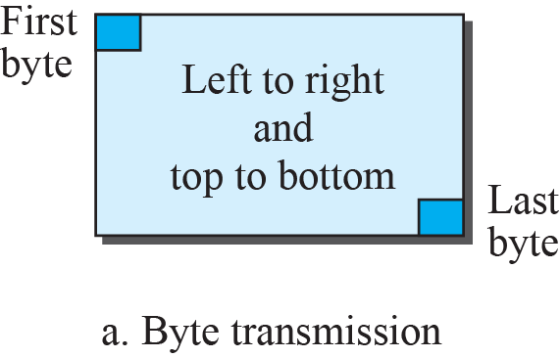
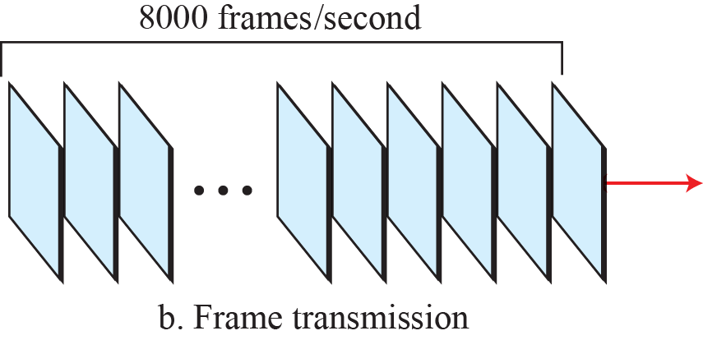
Figure 14.18: STS-1 frames in transition
14.<number>
Notes:
14.#

Slide 16
Example 14.1
Find the data rate of an STS-1 signal.
Solution
STS-1, like other STS signals, sends 8000 frames per second. Each STS-1 frame is made of 9 by (1 × 90) bytes. Each byte is made of 8 bits. The data rate is
14.<number>

Slide 17
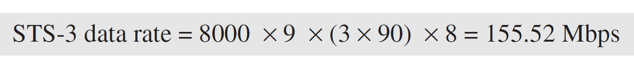
Example 14.2
Find the data rate of an STS-3 signal.
Solution
STS-3, like other STS signals, sends 8000 frames per second. Each STS-3 frame is made of 9 by (3 × 90) bytes. Each byte is made of 8 bits. The data rate is
14.<number>

Slide 18
Example 14.3
What is the duration of an STS-1 frame? STS-3 frame? STS-n frame?
Solution
In SONET, 8000 frames are sent per second. This means that the duration of an STS-1, STS-3, or STS-n frame is the same and equal to 1/8000 s, or 125 μs.
14.<number>

Slide 19
SONET Frames
The data rate of an STS – n signal is n times the data rate of an STS-1 signal
The duration of any frame is 125µs

Slide 20
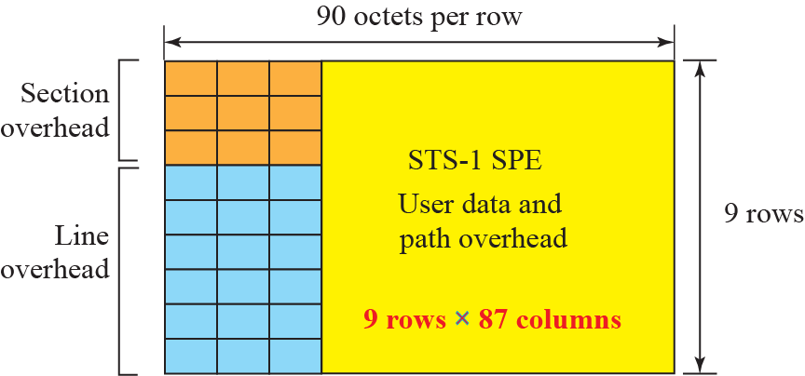
Figure 14.19: STS-1 frame format
SOH, LOH and SPE
14.<number>
Notes:
14.#

Slide 21
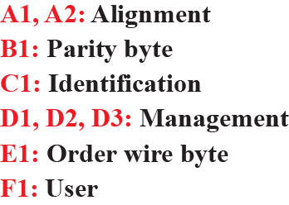
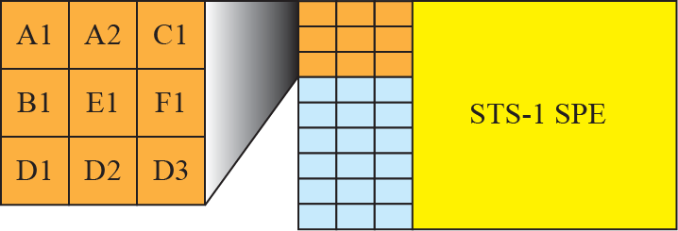
Figure 14.20: STS-1 frame: section overheads
oxF628
- all bytes of previous frame
- Helps for demultiplexing
- OA and M
- Communication between neighbouring devices (64kbps channel)
(Future use)
14.<number>
Notes:
14.#

Slide 22
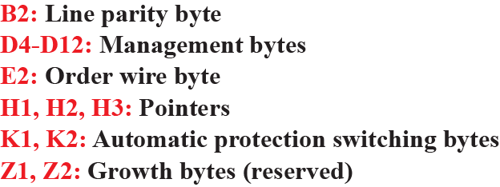
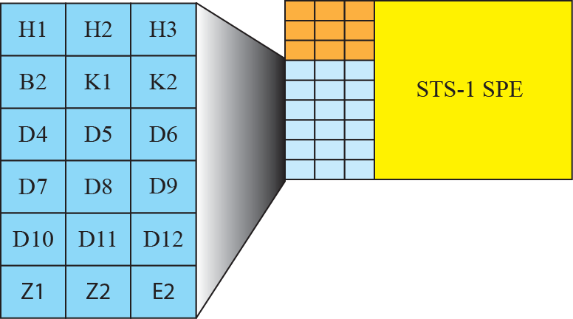
Figure 14.21: STS-1 frame: line overhead
- all bytes of previous frame
- OA and M
- Communication between multiplexers(line level)
- To detect problems with line terminating equipment
14.<number>
Notes:
14.#

Slide 23
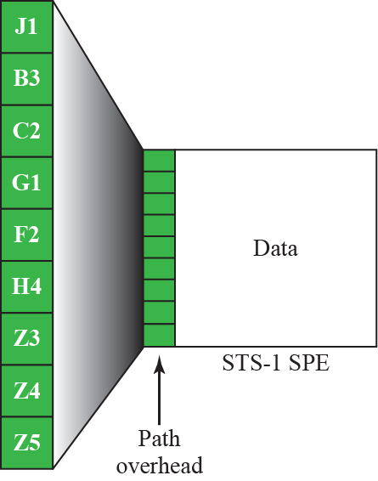
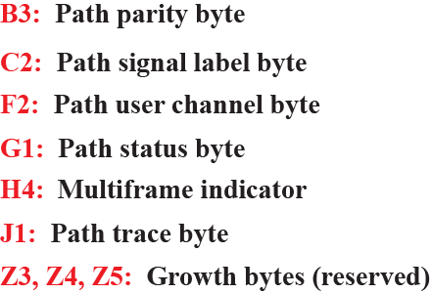
Figure 14.22: STS-1 frame path overhead
- Previous SPE
- To identify higher level protocol
- User needs
- Status to sender in reverse channel
- 64 byte string to verify the connection
14.<number>
Notes:
14.#

Slide 24
Section overhead is calculated for each SONET device (Regenerators and Multiplexers)
Line overhead (each multiplexer)
Path overhead is calculated for end-to-end devices

Slide 25
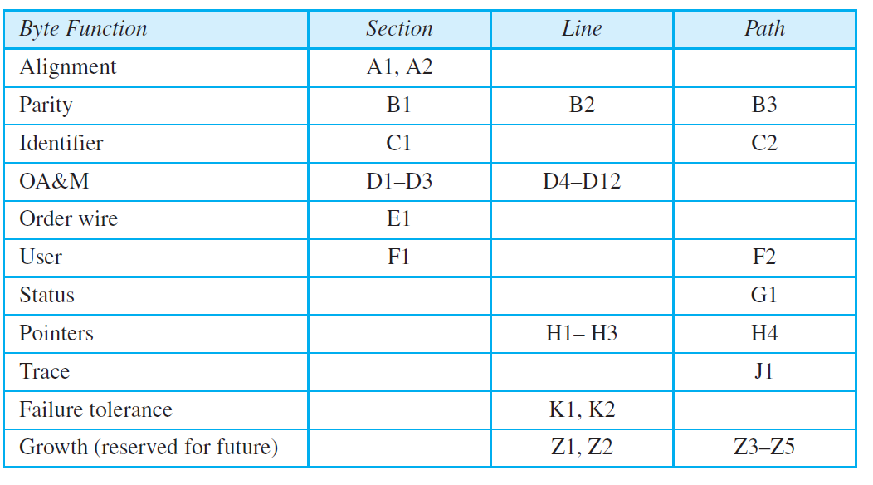
Table 14.2: SONETs overhead
E2
14.<number>

Slide 26
Example 14.4
What is the user data rate of an STS-1 frame (without considering the overheads)?
Solution
The user data part of an STS-1 frame is made of 9 rows and 86 columns. So we have
14.<number>

Slide 27
Encapsulation
SPE need to be encapsulated in an STS-1 frame.
SONET allows one SPE to span two frames
H1 and H2 pointers define the beginning of the SPE
These pointers are located in the line overhead because encapsulation occurs at a multiplexer

Slide 28
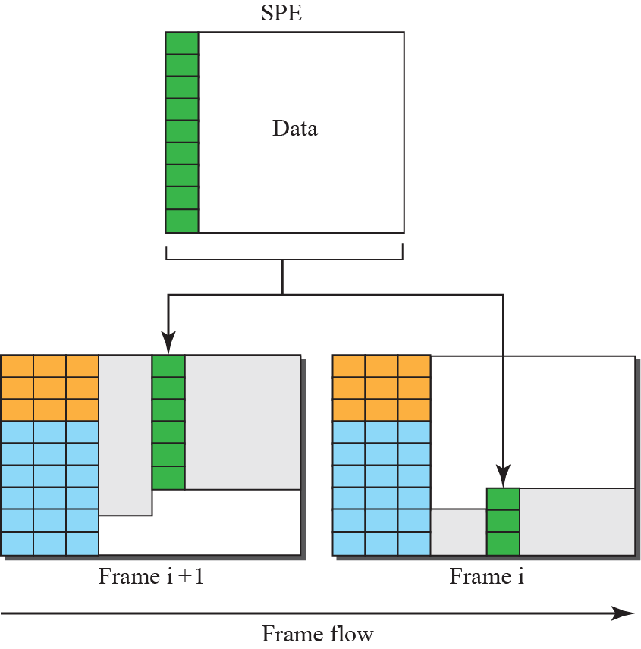
Figure 14.23: Offsetting of SPE related to frame boundary
14.<number>
Notes:
14.#

Slide 29
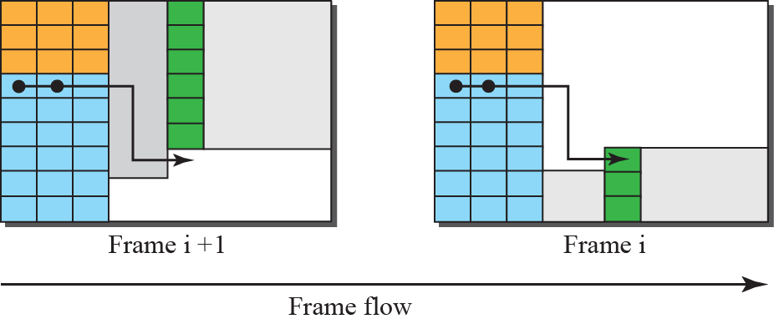
Figure 14.24: The use of H1 and H2 to show the start of SPE
14.<number>
Notes:
14.#

Slide 30
Example 14.5
What are the values of H1 and H2 if an SPE starts at byte number 650?
Solution
The number 650 can be expressed in four hexadecimal digits as 0x028A. This means the value of H1 is 0x02 and the value of H2 is 0x8A.
H3 byte is used for justification
If rate of payload is higher –extra byte inserted in H3 byte
If rate of payload is lower – empty byte after H3 byte
14.<number>

Slide 31
14.3.4 STS Multiplexing
In SONET, frames of lower rate can be synchronously time-division multiplexed into a higher-rate frame.
For example, three STS-1 signals (channels) can be combined into one STS-3 signal (channel), four STS-3s can be multiplexed into one STS-12, and so on, as shown in Figure 14.25.
14.<number>
Notes:
14.#

Slide 32
STS Multiplexing
Multiplexing is Synchronous TDM
All clocks in the network are locked to a master clock to achieve synchronization.
4 STS-3 signals can be multiplexed into one STS-12 signal.
However STS-3 signals need to be first demultiplexed into 12 STS-1 signals and then these 12 signals need to be multiplexed into an STS-12 signal

Slide 33
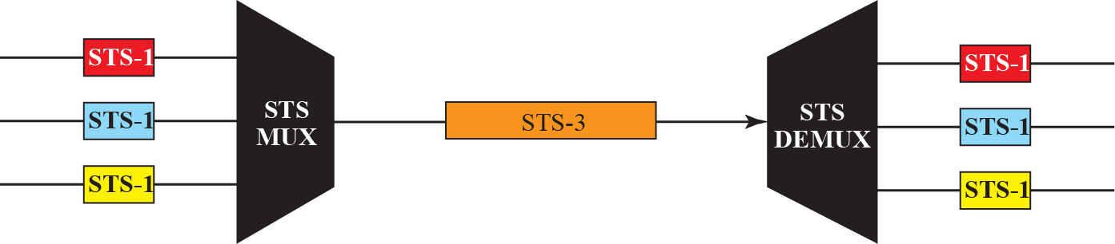
Figure 14.25: STS multiplexing/demultiplexing
14.<number>
Notes:
14.#

Slide 34
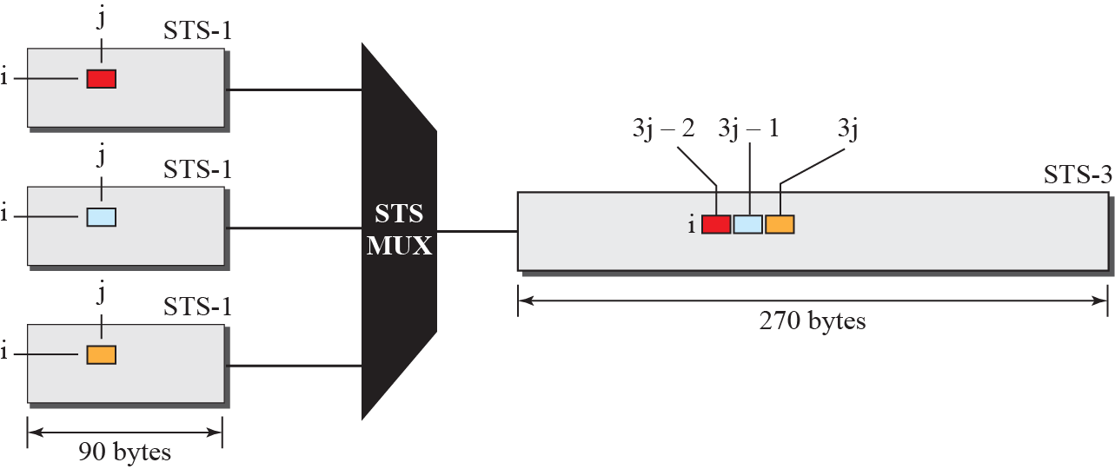
Figure 14.26: Byte interleaving
14.<number>
Notes:
14.#

Slide 35
Byte interleaving
A byte in an STS-1 frame keeps it row position but changes its column position.
Demultiplexing is easier than in statistical TDM.
Demultiplexer deals only with the position of the byte , not its function.
Byte Interleaving preserves the Section and Line overheads.
This may not be true with Path overheads.

Slide 36
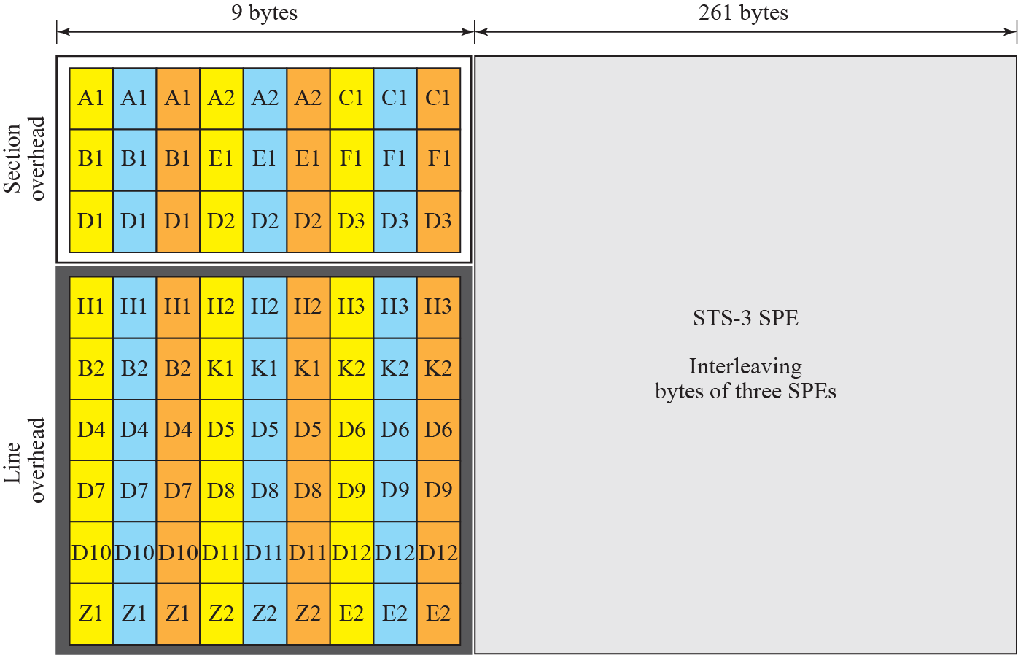
Figure 14.27: An STS-3 frame
14.<number>
Notes:
14.#

Slide 37
Concatenated Signal
In normal operation –an STS-n signal is made of n STS-1 signals
If we have a signal with a data rate higher than an STS-1 signal – SONET consider that as one concatenated STS-n signal.
Eg : STS3c
Here only 9 bytes of path overhead and 260 columns can be used for data.

Slide 38
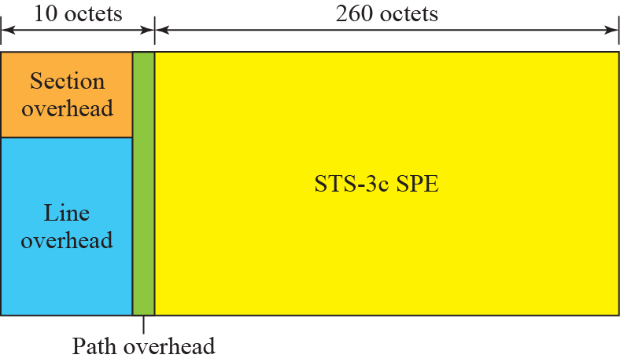
Figure 14.28: A concatenated STS-3c signal
14.<number>
Notes:
14.#

Slide 39
Add / Drop Multiplexer
It replaces a signal with another one.
It operates at the line layer.
Does not create any overheads.
It acts as a switch.
It removes one type of signal and adds same type of signal.
It simply replaces the corresponding bytes with new bytes.

Slide 40
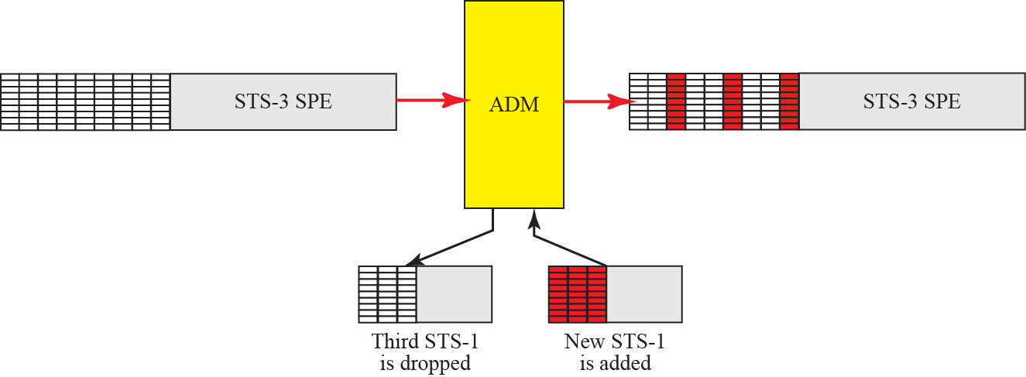
Figure 14.29: Dropping and adding frames in an add/drop multiplexer
14.<number>
Notes:
14.#

Slide 41
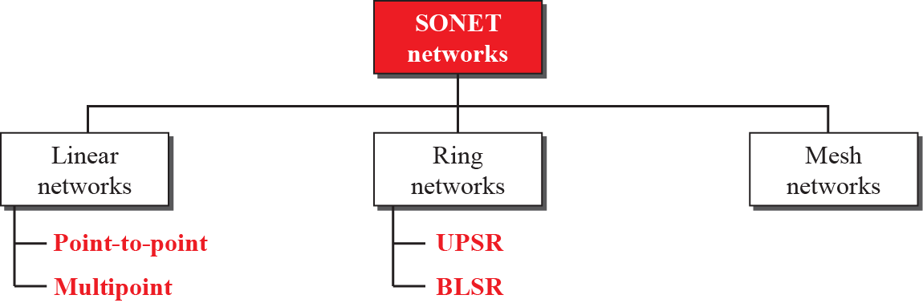
14.3.5 SONET Networks
Using SONET equipment, we can create a SONET network that can be used as a high-speed backbone carrying loads from other networks such as ATM (Section 14.4) or IP (Chapter 19).
We can roughly divide SONET networks into three categories: linear, ring, and mesh networks, as shown in Figure 14.30..
14.<number>
Notes:
14.#

Slide 42
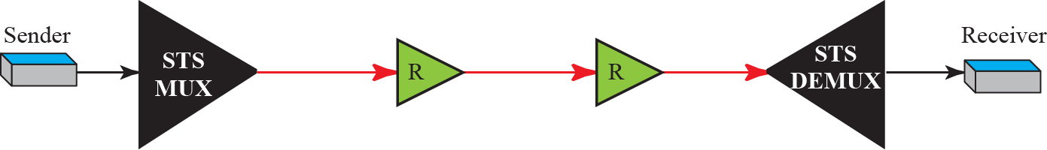
Linear Networks
Point-to-Point Networks
Made up of STS Multiplexer, STS Demultiplexer and zero or more regenerators.
No ADMs.
Signal flow can be unidirectional or bidirectional.

Slide 43
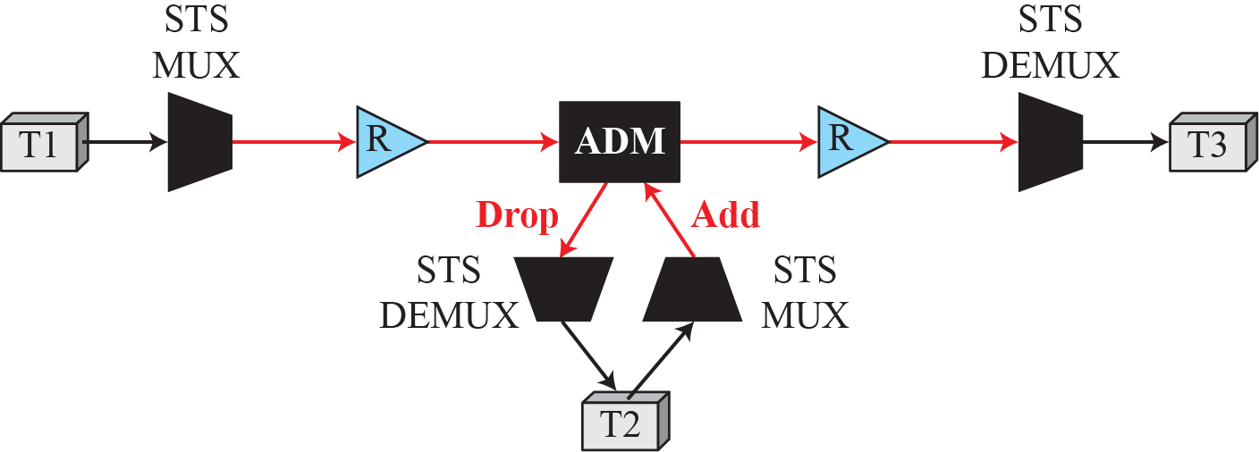
Figure 14.32: A linear SONET network
Multipoint Networks
Uses ADMs to allow communication between Terminals.
Each terminal can send data to one or more downstream terminals.
It can be Bidirectional also.
In the above figure T1 can send data to T2 and T3 simultaneously, whereas T2 can send only to T3.
14.<number>
Notes:
14.#

Slide 44
Automatic Protection Switching (APS)
Linear networks defines APS to create protection against failure.
It is defined at the Path and Line layers.
Idea is to provide redundancy.
Main line is referred to as the Work Line and the redundant line as the Protection Line.
There are Three schemes.

Slide 45
APS in Linear Networks
One-Plus-One APS:
Normally two lines – both are active all the time.
Receiving Multiplexer selects from the line with better quality.
Failure recovery is instantaneous but inefficient.
It is done at the Path layer.

Slide 46
APS in Linear Networks
One-to-One APS:
Normally two lines – data sent on working line until it fails.
At the time of failure receiver uses the reverse channel to inform the sender
Failure recovery is slower than that of one-plus-one scheme
More efficient (protection line can be used for data transfer when not in use)
It is done at the Line layer.

Slide 47
APS in Linear Networks
One-to-many APS:
It is similar to One-to-One except there is only one protection line for many working lines..
Not as secure as One-to-One. If more than one working line fails at the same time, protection can be given only to ne working line
It is done at the Line layer.

Slide 48
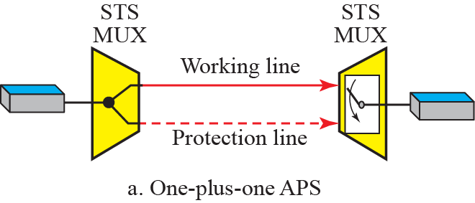
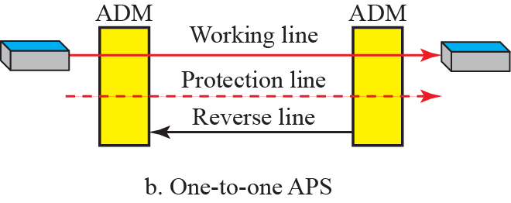
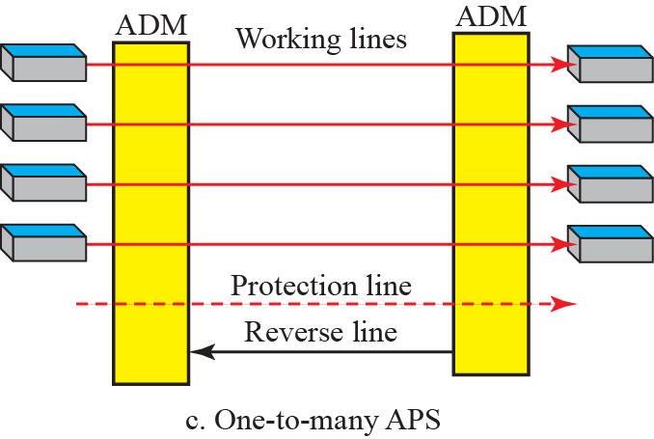
Figure 14.33: Automatic protection switching in linear networks
14.<number>
Notes:
14.#

Slide 49
Ring Networks
ADMs makes it possible to have SONET ring networks
Unidirectional Path Switching Ring:(UPSR)
2 rings, one working ring and one protection ring.
Idea is similar to one-plus-one APS
Same signal flows in both rings in different directions. Receiver selects from the ring with better quality.
Failure recovery is instantaneous but inefficient(Wastage of Bandwidth).
Maintenance is done at the Path layer.

Slide 50
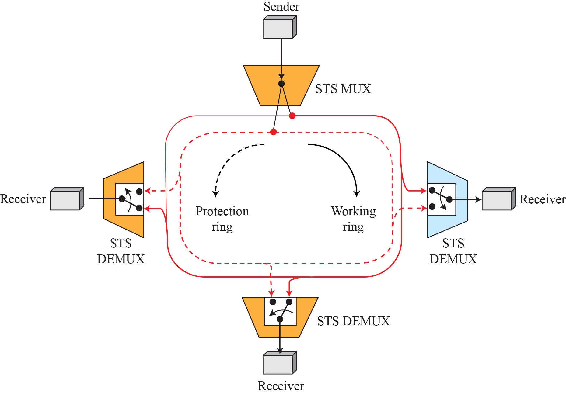
Figure 14.34: A unidirectional path switching ring
Two-way connection
Selection Switch
14.<number>
Notes:
14.#

Slide 51
Ring Networks
Bidirectional Line Switching Ring(BLSR)
2 rings for working line and two for protection line, so 4 rings.
Idea is similar to one-to-one APS
If a working ring fails the receiver uses the reverse channel to inform the upstream node to use protection ring.
. Failure recovery in different situations is possible.
Failure discovery is done at the Line layer by ADMs.

Slide 52
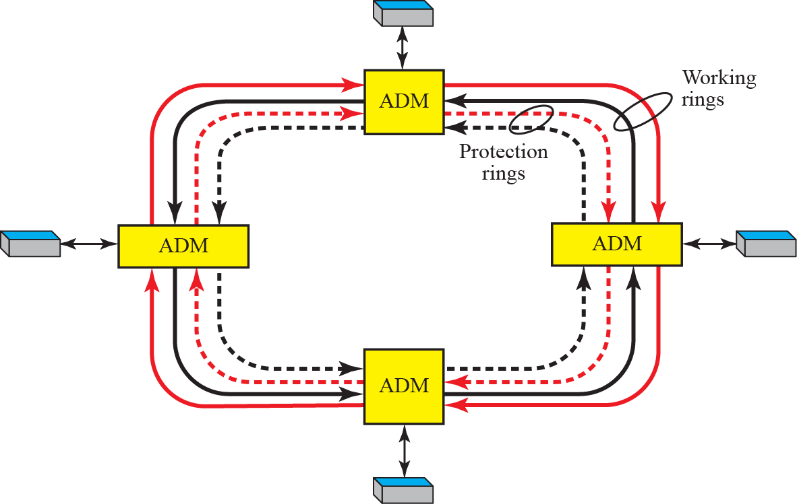
Figure 14.35: A bidirectional switching ring
14.<number>
Notes:
14.#

Slide 53
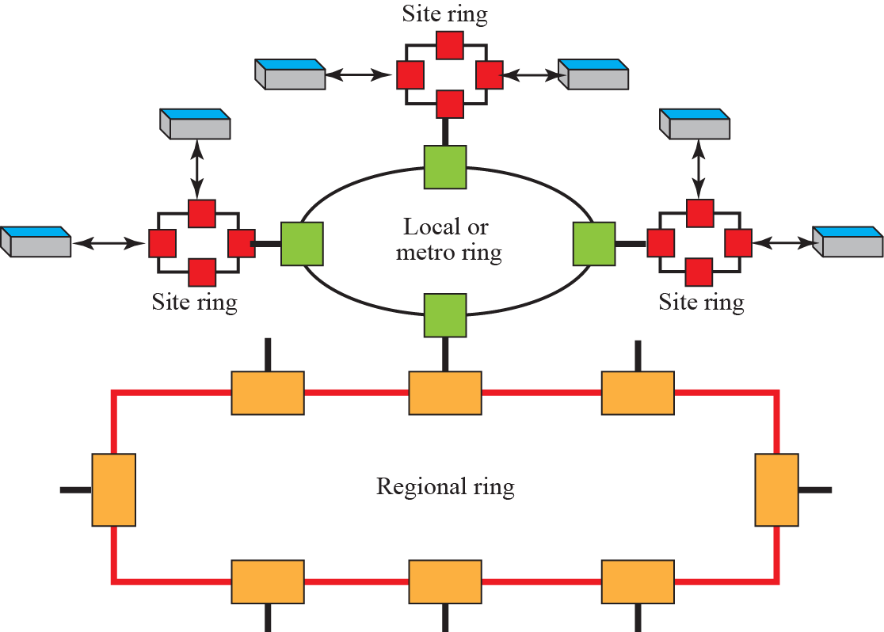
Figure 14. 36: A combination of rings (Wide Area Ring Networks)
14.<number>
Notes:
14.#

Slide 54
Mesh Networks
Problem with Ring networks is lack of Scalability.
To upgrade(when traffic increases) we need to upgrade lines as well as ADMs.
For better performance we go for Mesh Networks.

Slide 55
Mesh Networks
Here a switch is called a cross-connect with input and output ports.
Input port – takes OC-n, changes to STS-n, demultiplexes into STS-1 signals and give to output port.
Output port – takes STS-1 signals, multiplexes to STS-n signals and makes an OC-n for transmission.
Each port acts as both input and output ports, so both Mux and Demux required in each port.

Slide 56
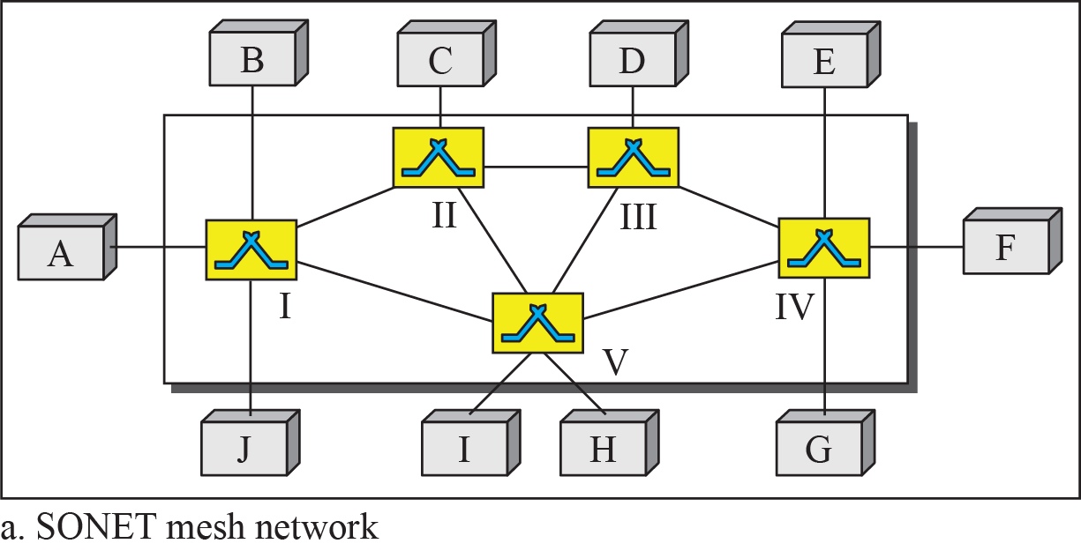
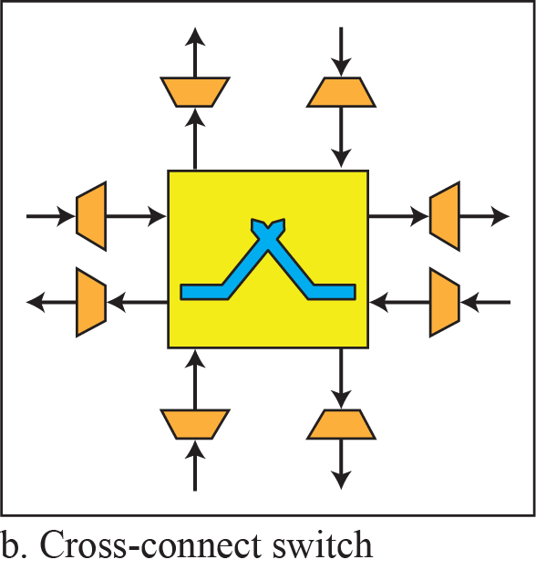
Figure 14.37: A mesh SONET network
14.<number>
Notes:
14.#

Slide 57
14.3.6 Virtual Tributaries
SONET is designed to carry broadband payloads. Current digital hierarchy data rates (DS-1 to DS-3), however, are lower than STS-1 for backward compatibility.
To make SONET backward-compatible with the current hierarchy, its frame design includes a system of virtual tributaries (VTs).
A virtual tributary is a partial payload that can be inserted into an STS-1 and combined with other partial payloads to fill out the frame.
Instead of using all 86 payload columns of an STS-1 frame for data from one source, we can subdivide the SPE and call each component a VT.
14.<number>
Notes:
14.#

Slide 58
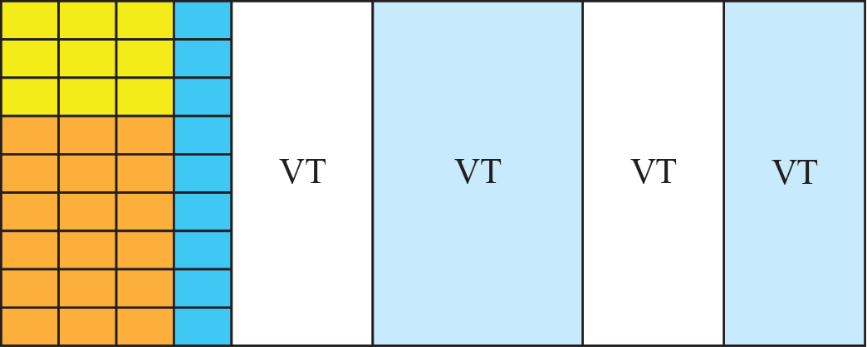
Figure 14.38: Virtual tributaries
Four Types
Number of columns varies
Interleaved column by column
14.<number>
Notes:
14.#

Slide 59
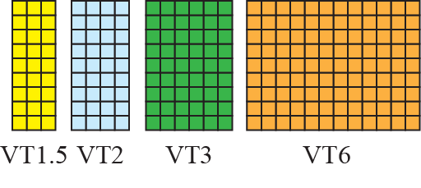
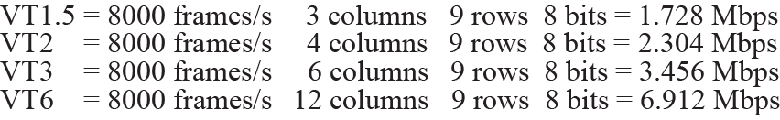
Figure 14.39: Virtual tributary types
14.<number>
Notes:
14.#

Slide 60
        Thank You
1.<number>

